Slide 1
BIM 6th Semester Project Guidelines
Tribhuvan University | Faculty of Management
IT 352: Project
Sumit Ghising | NCCS

Slide 2


Slide 3


Slide 4
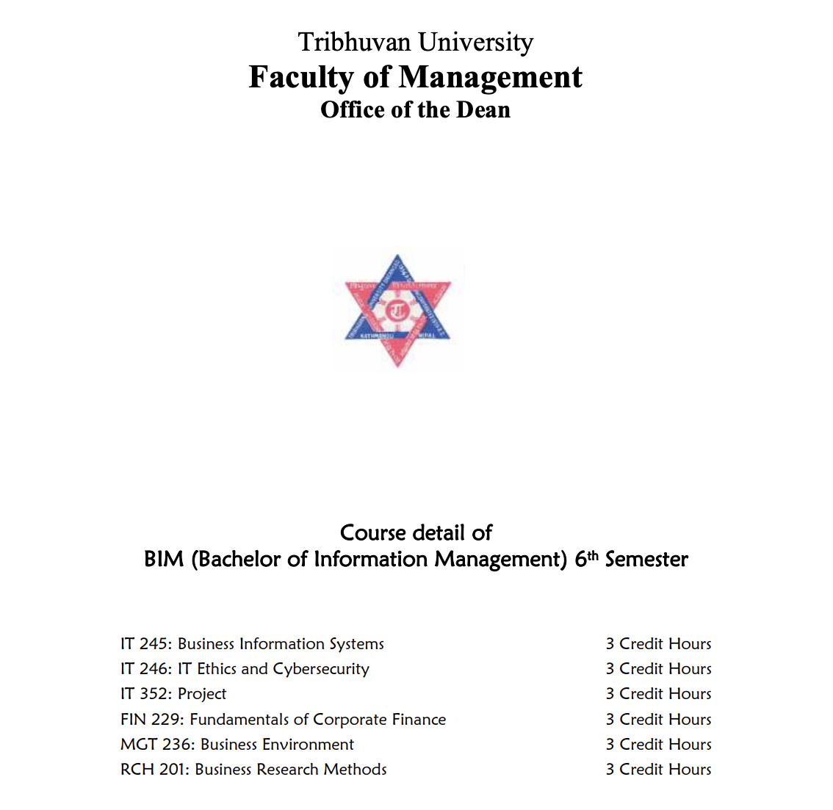

Slide 5
Course Description
Course: IT 352: Project (BIM 6th Semester)
Purpose: Apply theoretical and practical skills to develop a real-world software application
Focus Areas:
Planning, analysis, design, and implementation
Technical and project management skills
Group Size: Up to 2 members per group
Project Freedom:
Choose an organization or develop your own innovative idea

Slide 6
Course Objectives
Upon completion, students will be able to:
Develop a real-world software application
Create a high-quality project report
Gain technical expertise in software development
Master time and resource management
Build effective team skills

Slide 7
Project Phases
Proposal Defence:
Submit a proposal document
Present and get approval to proceed
Pre-Defence:
Submit and present a draft report
Approval needed for final defence
Final Defence:
Submit final report
Present to external examiners
Justify methods and conclusions

Slide 8
Proposal Contents
Key Sections:
Title Page
Introduction & Problem Statement
Objectives
Development Methodology
Requirement Identification & Feasibility Study
Literature Review
Analysis and Design Tools
Implementation Tools (Front End, Back End)
Expected Outcome
Project Schedule
References (APA 7th Style)

Slide 9
Report Contents
Structured Chapters:
Chapter I: Introduction
Background, Problem Statement, Objectives
Literature Review, Scope & Limitations
Chapter II: System Development
Requirement Analysis, Feasibility Study
UI Design, Database/Object-Oriented Design
Tools, Module Description, Testing
Chapter III: Conclusion
Summary, Conclusion, Recommendations
Additional Sections: Declaration, Acknowledgements, Abstract, References, Appendices

Slide 10
Evaluation Breakdown
Marks Allocation:
Supervisor: 50% (20% Pre-Defence, 30% Final Defence)
Internal Examiner: 10% (5% Pre-Defence, 5% Final Defence)
Head/Program Coordinator: 10% (5% Pre-Defence, 5% Final Defence)
External Examiner(s): 30% (Final Defence)
Total: 100%

Slide 11
Report Format Guidelines
Page Numbering:
Roman (ii) for prelim pages
Numeric (1) from Chapter 1
Paper Size & Margins:
A4, 1" (Top, Bottom, Right), 1.5" (Left)
Paragraphs:
Times New Roman, 12pt, 1.15 line spacing, justified
Headings:
16pt (Chapter), 14pt (Section), 12pt (Subsection)
Figures/Tables:
Chapter-wise numbering (e.g., Figure 1.1)
Captions: Times New Roman, 12pt, bold, centered

Slide 12
Proposal Report Contents

Slide 13
Title Page
Introduction
Introduction
Problem Statement
Objective
Development Methodology(Like Waterfall, Incremental, etc)
Methodology
Requirement Identification and Feasibility Study
Functional Requirements(with Use Case Diagram)
Non-Functional Requirements
Feasibility Study
Technical
Operational
Economic

Slide 14
Related Work / Literature Review
Analysis and Design Tools
Implementation tools (Front End, Back End)
Expected Outcome
Project Schedule (Gantt chart showing the project timeline)
References(follow APA 7th Style)

Slide 15
Project Report Contents

Slide 16
Title Page
STUDENT DECLARATION
SUPERVISOR’S RECOMMENDATION
APPROVAL SHEET
ACKNOWLEDGEMENTS
ABSTRACT
LIST OF FIGURES
LIST OF TABLES
LIST OF ABBREVIATIONS

Slide 17
CHAPTER I: INTRODUCTION
1.1 Background of the Project
1.2 Problem Statement ..
1.3 Objectives
1.4 Review of Related Work and Literature
1.5 Development Methodology
1.6 Scope and Limitations
1.6.1 Scope
1.6.2 Limitations
1.7 Report Organization

Slide 18
CHAPTER II: SYSTEM DEVELOPMENT PROCESS
2.1 Analysis (Requirement Analysis, Feasibility Study, Structured / Object- Oriented Modelling)
2.1.1 Requirement Analysis
i. Functional Requirement(Use case diagram showing functional Requirement)
ii. Non-Functional Requirement
2.1.2 Feasibility Study
i. Technical
ii. Operational
iii. Economic
iv. Schedule

Slide 19
2.1.3 System Modelling
If structured approach:
Data modelling using ER Diagrams
Process modelling using DFD
If object oriented approach:
Object modelling using Class and Object Diagrams
Dynamic modelling using State and Sequence Diagrams
Process modelling using Activity Diagrams

Slide 20
2.2 System Design
If structured approach:
2.2.1 Interface and Dialogue Design
2.2.2 Database Design: Transformation of ER to relations and normalizations
If object oriented approach:
2.2.1 Refinement of Classes and Object 2.2.2 Component Diagram
2.2.3 Deployment Diagram

Slide 21
2.3 Implementation (Tools and Technologies Used, Module Description, Testing)
2.3.1 Tools used (CASE tools, programming languages, database platforms)
2.3.2 Implementation details of modules (description of procedures/ functions/ classes/ methods)
2.3.3 Testing
Test cases for Unit Testing
Test cases for System Testing

Slide 22
CHAPTER III: CONCLUSION AND RECOMMENDATION
3.1 Summary
3.2 Conclusion
3.3 Recommendation

Slide 23
REFERENCE (Follow APA 7 style)
APPENDIX

